Slide 1

Enhancing Medical Education through Immersive Virtual Reality
MetaMed:
Group Members:
Dawood Sarfraz (20P-0153)
Waleed Akram (20P-0640)
Shoaib Akhtar (20P-0147)) Project Supervisor:
Dr. Muhammad Amin

Slide 2
Table Of Content
Introduction
Execution Plan
UML Diagrams
Tools Used
App Highlights
Teamwork
Demo

Slide 3
1. Introduction

Slide 4
Introduction
A VR-based medical training platform.
Develop VR medical simulations with haptic feedback, enabling realistic training for medical students.
Reduce costs and ethical concerns associated with traditional surgical training methods.
Unity 3D and Blender for environments.

Slide 5
2. Execution Plan

Slide 6
Execution Plan
FYP-1
Environment setup in Unity3D and Blende
Assets of App (Patient body, bed, tables and environment).
Developed basic animations in 3D.
FYP-2
Environment rendering to HDR.
Rendering of Assets .
Handling of Assets(Syringes, Pill Bottle, Sanitizers).
Integration in oculus.
Testing in oculus set.

Slide 7
3. UML Diagrams

Slide 8
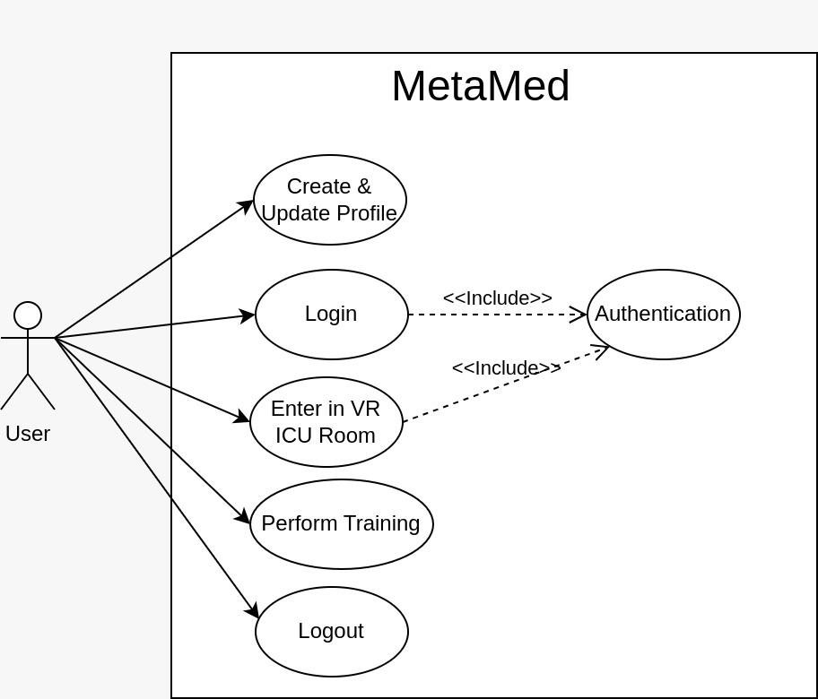
Use case Diagram
Fig.1.0. Use Case Diagram

Slide 9
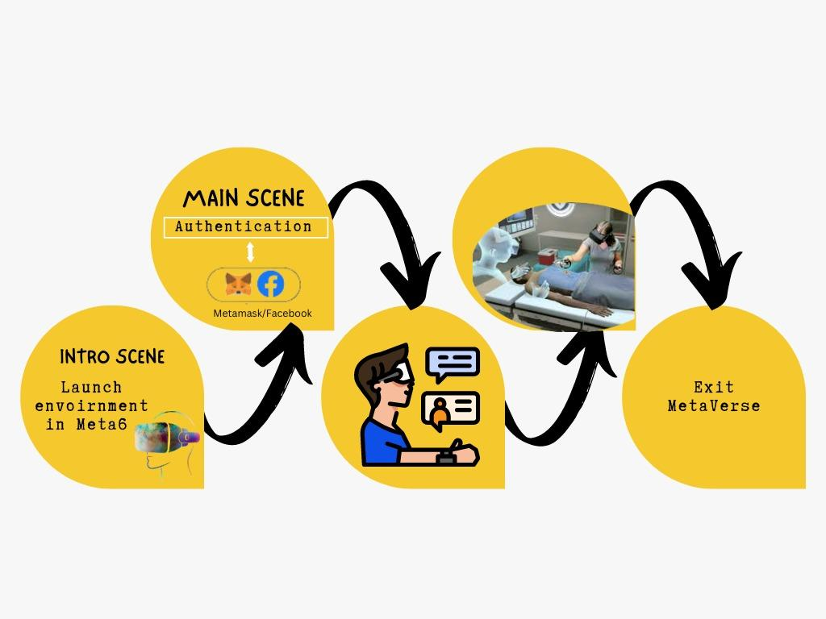
System Diagram
Fig.2.0. System Diagram

Slide 10
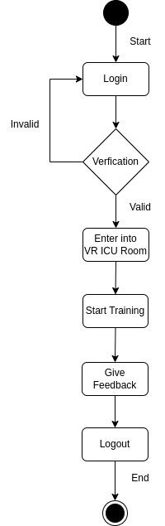
Activity Diagram
Fig.3.0. Activity Diagram

Slide 11
4. Tools Used
Blender
Unity 3D
VR Headset
Microsoft Visual Studio
C#
VRTK

Slide 12
5. App Highlights

Slide 13
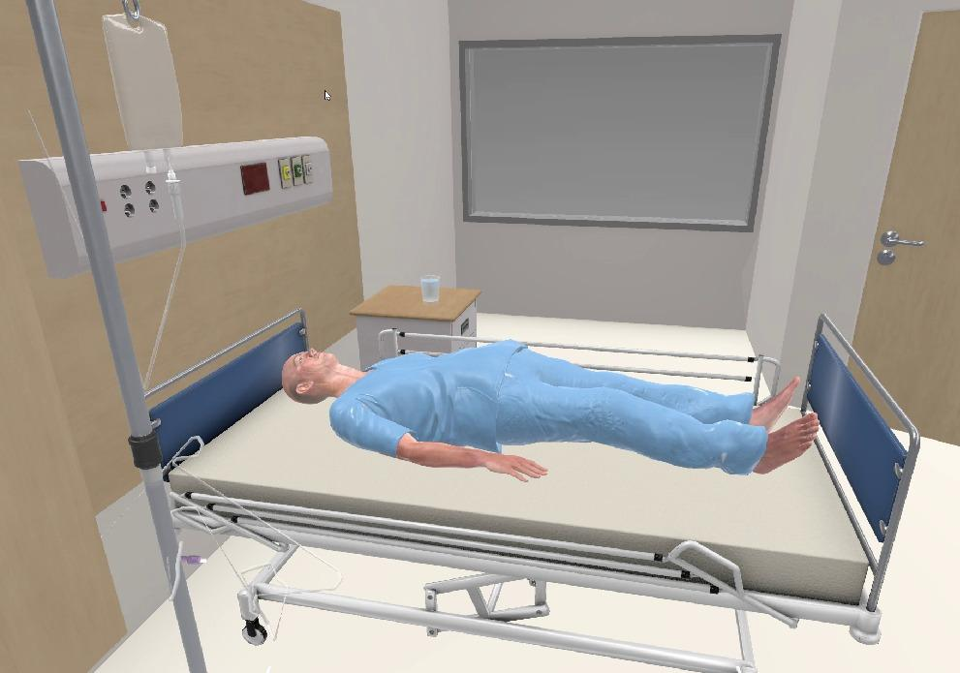
Patient Room
Fig.4.0. Patient Room

Slide 14
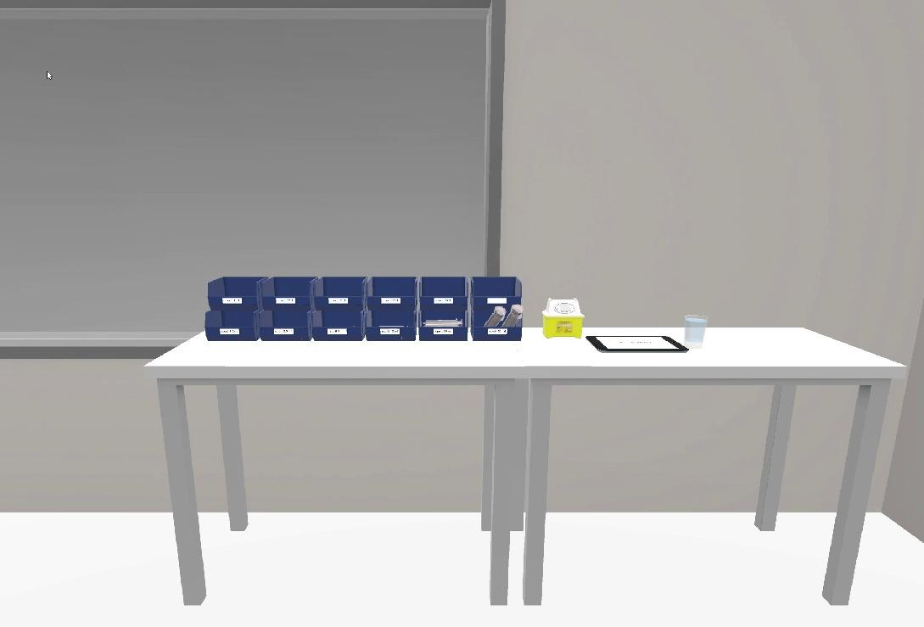
Tools Area
Fig.5.0. Tools Area

Slide 15
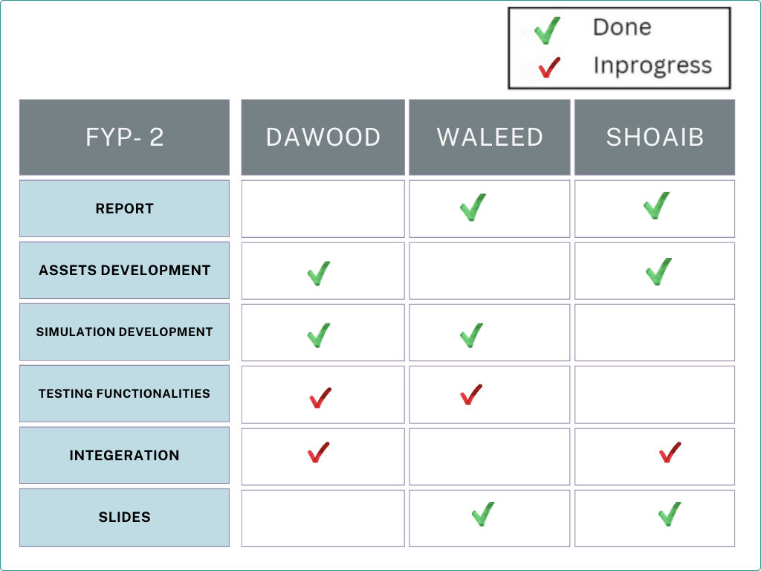
6. Teamwork

Slide 16
Demo Video

